Slide 1
ME 203 Introduction to MATLAB

Slide 2
Relational Operators
MATLAB uses mostly standard relational operators
equal
not equal
greater than
less than
greater or equal
less or equal
==
~=
>
<
>=
<=
See help . for a detailed list of operators

Slide 3
Relational Operators
Recall relational operators make True/False comparisons
Example:
A =
1 2 3 4 5 6 7 8 9
tf1 = A <=4
tf1 =
1 1 1 1 0 0 0 0 0
All cases that are true are 1 and all cases that are false are zero

Slide 4
Relational Operators
A =
1 2 3 4 5 6 7 8 9
B =
7 6 5 4 3 2 1 0 -1
More examples:
>> tf2 = A > B
tf2 =
0 0 0 0 1 1 1 1 1
Arrays being compared must have same dimensions

Slide 5
Relational Operators
A =
1 2 3 4 5 6 7 8 9
B =
7 6 5 4 3 2 1 0 -1
More examples:
>> tf3 = (A==B)
tf3 =
0 0 0 1 0 0 0 0 0

Slide 6
Relational Operators
A =
1 2 3 4 5 6 7 8 9
B =
7 6 5 4 3 2 1 0 -1
More examples:
>> tf4 = B-(A>2)
tf4 =
7 6 4 3 2 1 0 -1 -2

Slide 7
Logical Operators
AND &
OR |
NOT ~
Example:
>> A=1:9;
>> tf2 = ~(A>4)
tf2 =
1 1 1 1 0 0 0 0 0
>> tf3 = (A>2)&(A<6)
tf3 =
0 0 1 1 1 0 0 0 0

Slide 8
Order of precedence
Precedence | Operator type
First | Parentheses; evaluated starting with the innermost pair
Second | Arithmetic operators and logical NOT (~); evaluated from left to right
Third | Relational operators; evaluated from left to right
Fourth | Logical AND
Fifth | Logical OR

Slide 9
Example
Test scores out of 100 for students are given as a vector
score=[90 72 57 48 20 75]. To pass the test a student must score >=50. Create a vector of 1s and 0s denoting pass/fail.
>> score = [90 72 57 48 20 75];
>> result = (score>=50)
result =
1 1 1 0 0 1

Slide 10
if Statements
We use conditional statements to describe our decision making process everyday
If I get a raise, I will buy a new car.
If I get a raise,
I will buy a new car
. (period)
if logical expression
commands
end

Slide 11
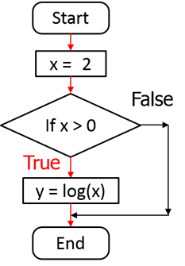
if Statements
Example: Suppose x is a scalar. We want to calculate y=log(x) only when x>0
x=2;
if x>0
y=log(x)
end
y =
0.6931

Slide 12
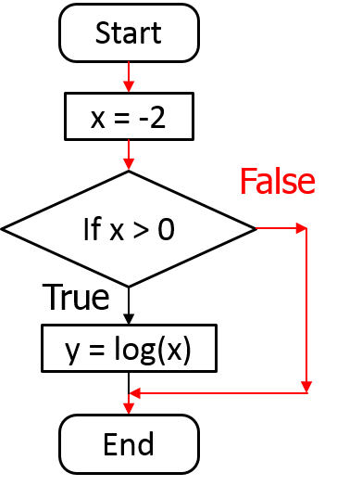
if Statements
Example: Suppose x is a scalar. We want to calculate y=log(x) only when x>0
x=-2;
if x>0
y=log(x)
End
No result

Slide 13
if Statements
Example: What will the value of z be after the following statements?
z=-3;
if z <= 0
z = 10;
end
z = z + 1
Answer:
z =
11

Slide 14
if/else Statements
Adding to our conditional
If I get at least a $100 per week raise, I will buy a new car; else, I will put the raise into savings.
If I get at least a $100 per week raise,
I will buy a new car
else,
I will put the raise into savings
. (period)

Slide 15
if/else Statements
if logical expression
commands 1
else
commands 2
end

Slide 16
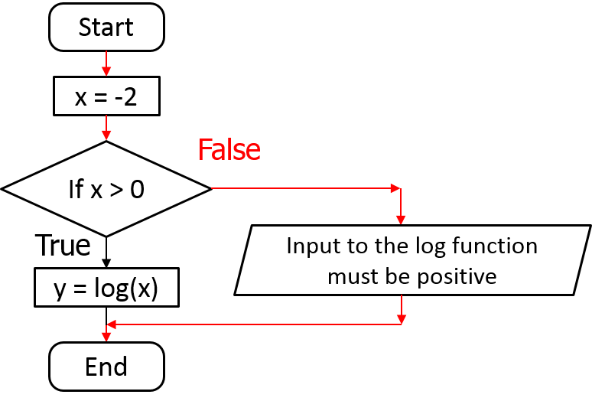
if/else Statements
Example: Suppose x is a scalar. We want to calculate y=log(x) when x>0. When x <=0, display “Input to log fn must be positive”.

Slide 17
if/else Statements
Example: Suppose x is a scalar. We want to calculate y=log(x) when x>0. When x <=0, display “Input to log fn must be positive”.
x=2;
if x>0
y=log(x)
else
disp (‘The input to the log function must be positive’)
end
y =
0.6931
x=-2;
if x>0
y=log(x)
else
disp (‘The input to the log function must be positive’)
end
The input to the log function must be positive

Slide 18
if/else/elseif
Basic flow-control, common to all languages
MATLAB syntax is somewhat unique
IF ELSE
ELSEIF
if cond
commands
end
if cond
commands1
else
commands2
end
if cond1
commands1
elseif cond2 commands2
else
commands3
end
Conditional statement: evaluates to true or false
No need for parentheses!

Slide 19
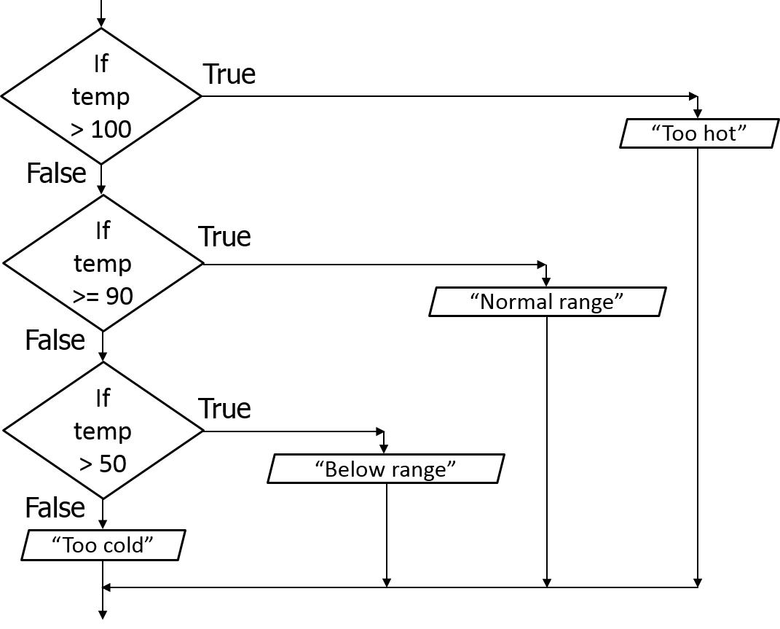
Nested Structures – If statements
Example:
Indicate equipment status based on the temperature
The normal operating range is 90-100
If the temperature is outside of the range give the an error message

Slide 20
Nested Structures – If statements
if temp > 100
disp(’Too hot - equipment malfunctioning’)
elseif temp >= 90
disp(’Normal operating range’)
elseif temp > 50
disp(’Below desired operating range’)
else
disp(’Too cold - turn off equipment’)
end
If both else and elseif are used, else must come after elseif

Slide 21
Nested Structures
Nested if statements structure
if conditional statement
commands
elseif conditional statement
commands
else
commands
end
if conditional statement
commands
if conditional statement
commands
end
commands
end
OR
Notes:
if temp>50
if temp>=90
if temp>100
disp('Too hot - equipment malfunctioning')
end
if temp<100
disp('Normal operating range')
end
end
if temp<90
disp('Below desired operating range')
end
else
disp('Too cold - turn off equipment')
end

Slide 22
Repetition Structures
Often called loops
Used for code that will be repeated
Each repetition is called a pass
Loops allow you to repeat sequences of code until some criterion is met
5 basic parts
A parameter (loop variable) which determines whether or not to end the loop
Initialization of this parameter
A way to change this parameter each time we go through the loop
A comparison (using the parameter) to a criterion used to decide when to end the loop
Calculations to do inside the loop (command block)

Slide 23
For Loops
For loops are used when you know in advance how many passes through the loop you need to make
Matlab syntax
The loop variable
Is defined as a vector
Is a scalar within the command block
Does not have to have consecutive values (but it's usually cleaner if they're consecutive)
The command block
Anything between the for line and the end
for loop_variable = start_val:increment:end_val commands
end
Command block

Slide 24
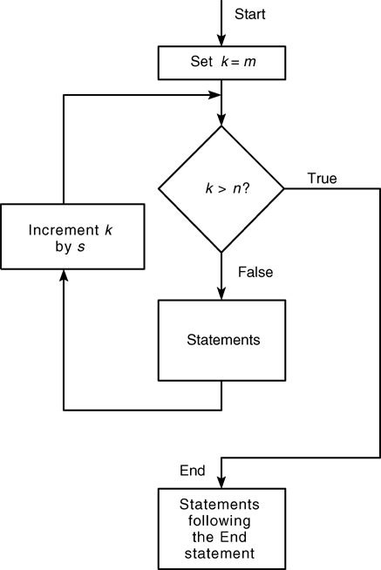
For Loop Flow Chart
k= m:s:n
m is the initial value of a loop
s is the increment value
n is the terminating value
Will loop until k exceeds n
Figure 4.5-1

Slide 25
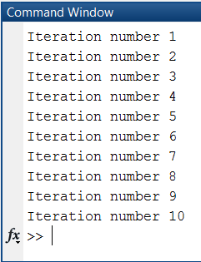
For Loops
for loop_var = 1:10
fprintf('Iteration number %d\n', loop_var)
end

Slide 26
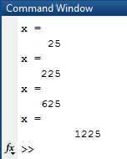
Example
for k=5:10:35
x=k^2
end
1. The loop variable k is assigned an initial value of 5
2. x is calculated (x=k^2)
3. Each pass through the loop increments k by 10 and calculated x until k exceeds 35
Loop variable is a vector
Command block with loop variable, k
Note the expression k=5:10:35 or generically k= m:s:n
m is the initial value of a loop, which is incremented by the increment value, s. The loop continues until the loop variable exceeds the terminating value, n.

Slide 27
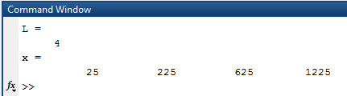
Example
Rewrite previous example using indexing and script formatting
% Indexing example
clc; clear all; format compact
%Given
k=5:10:35;
%Calculate length of vector k
L = length(k)
%Calculate x
for i=1:L
x(i) = k(i)^2;
end
%Display answer
x
Spacing of 1
Note: no need of .^ operator

Slide 28
For loops
Example: Iterate the loop over odd integers from 273 to 1 (inclusive).
for k = ???
% commands
% commands
end
Answer: k = 273:-2:1

Slide 29
Nested Structures
Nested for loop and if statement structure example
for i=start:increment:end
commands
if conditional statement
commands
end
commands
end

Slide 30
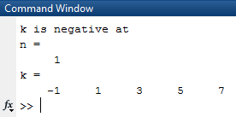
Nested Structures- for and if
Calculate k=2*n-3 for n=1:5. Show an error message if k is negative and the
index of the negative value
% Nested for and if example
clc; clear all; format compact
% Calculate k
for n=1:5
k(n)= 2*n-3;
if (k(n)<0)
disp ('k is negative at')
% Display index of negative value
n
end
end
% Display result
k

Slide 31
Pause command
pause - temporarily stops MATLAB execution and waits for the user to press any key
pause(n) - pauses execution for n seconds before continuing

